Slide 1


Slide 2
From nature to mathematics
Biological neuron Mathematical equivalent
x₁
w₁
w₂
f
x₂
Σ
f(w₁x₁+ w₂x₂ + w₃x₃)
w₃
x₃

Slide 3
Building a network
Output of one neuron → inputs to other neurons
f
f
f
f
f
f
f
f
f

Slide 4
Universal Approximator Theory versus Practice
hidden layer
Theory: 1 hidden (very wide) layer with non-linear activations is enough to solve any problem.
Practice:
Computationally very hard
Does not generalize well to unseen data
Enter deep learning = many hidden layers.
Made feasible by GPUs and better techniques.
f
f
f
f
f
f
input layer
output layer

Slide 5
Finding the optimal weights
Forward pass (calculate error w.r.t ground truth)
Backwards pass (update weights to decrease error)
Repeat until no
further improvement
f
f
f
f
...
f
f
f
f
...
f
f
f
f
...

Slide 6
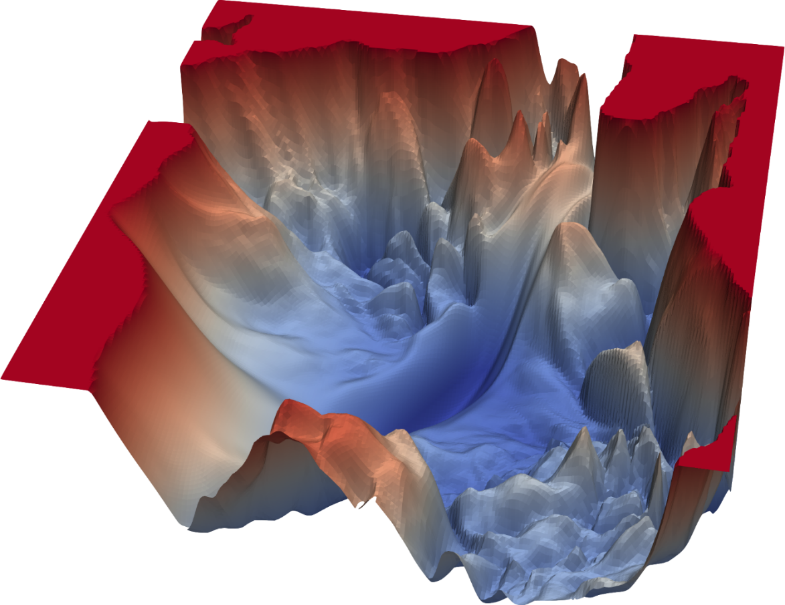
Problem 1: Local Minima (in loss landscape)
Forward pass (calculate error w.r.t ground truth)
Backwards pass (calculate Δw that decreases error)
Repeat until no
further improvement
Solution 1: vary batch size
Solution 2: vary learning rate in an epoch – one cycle
Solution 3: adaptive momentum

Slide 7


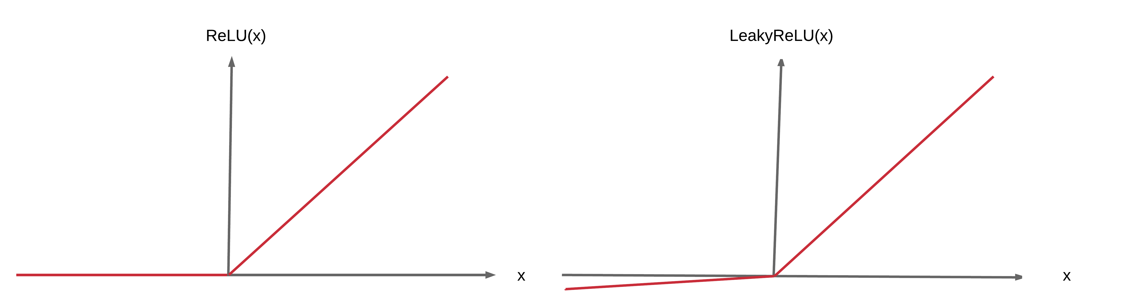
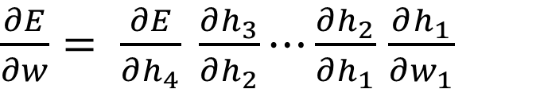
Problem 2: Vanishing Gradients
Forward pass (calculate error w.r.t ground truth)
Backwards pass (calculate Δw that decreases error)
Repeat until no
further improvement
f
f
f
...
f
f
$\frac{∂E}{∂w}= \frac{∂E}{∂h_{4}} \frac{∂h_{3}}{∂h_{2}}⋯\frac{∂h_{2}}{∂h_{1}}$ $\frac{∂h_{1}}{∂w_{1}}$
Solution: Use rectified linear activation function (RELU)

Slide 8
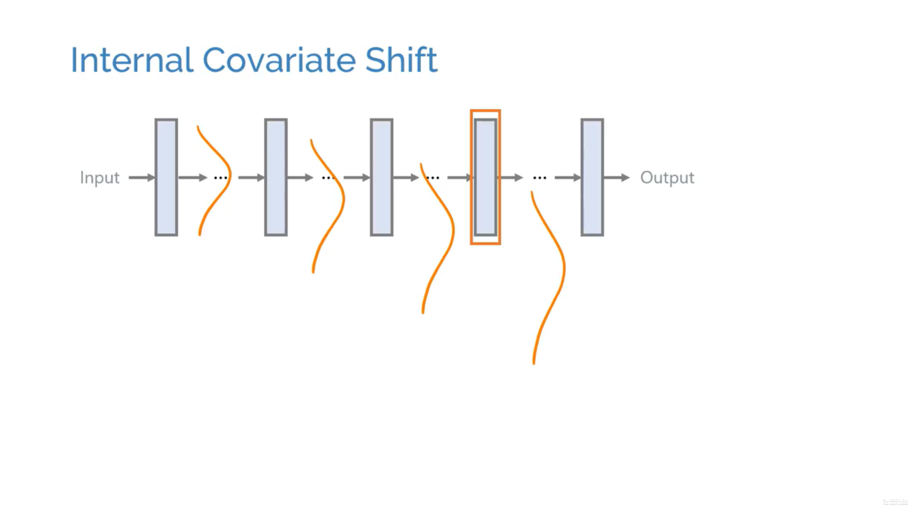
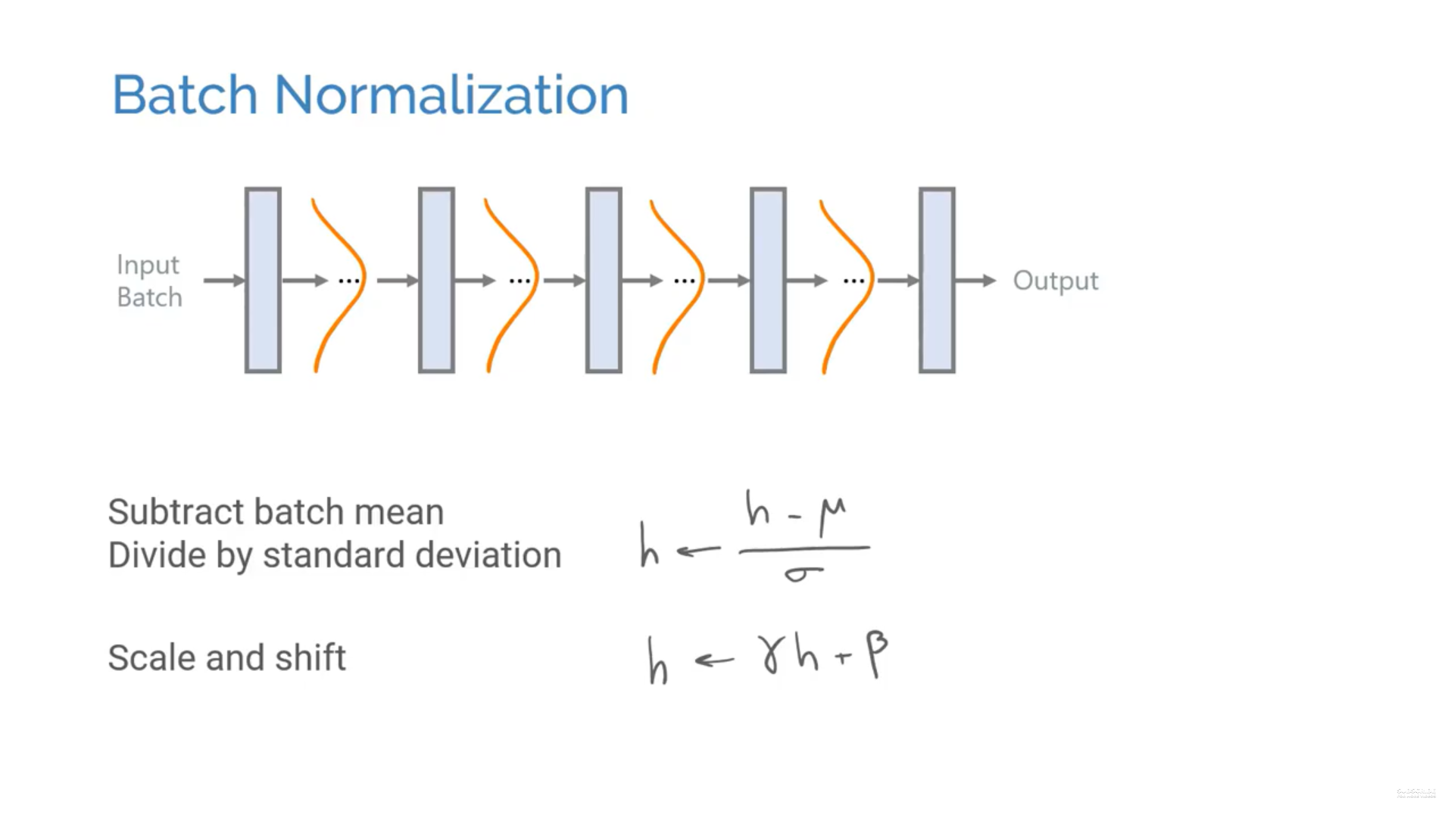
Problem 3: Covariate Shift
Forward pass (calculate error w.r.t ground truth)
Backwards pass (calculate Δw that decreases error)
Repeat until no
further improvement
Problem: Weights are updated under the assumption that prior layers output values with a given distribution, but these distributions also change during backprop!
Solution: Batch (or Layer) normalization during forward prop. Subtract batch mean
Divide by standard deviation

Slide 9
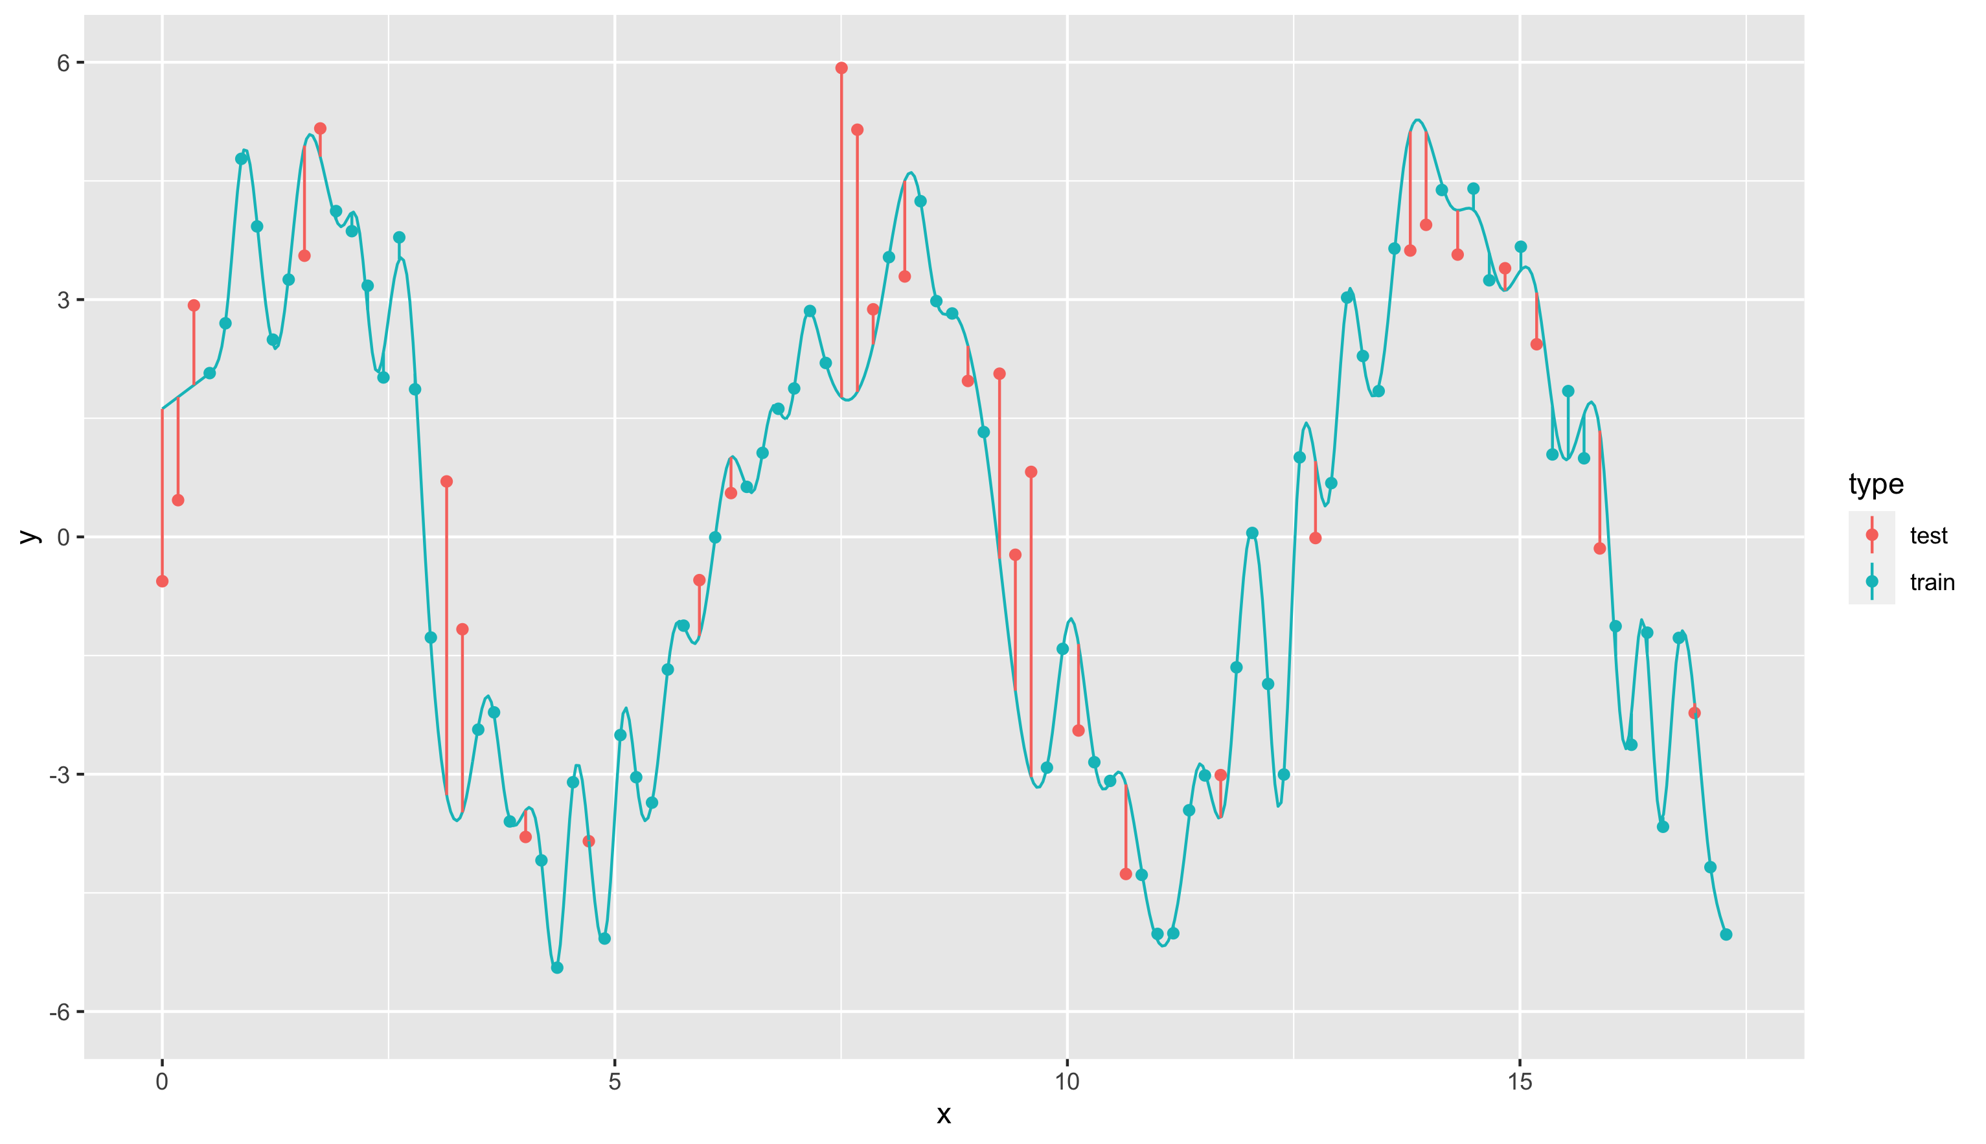
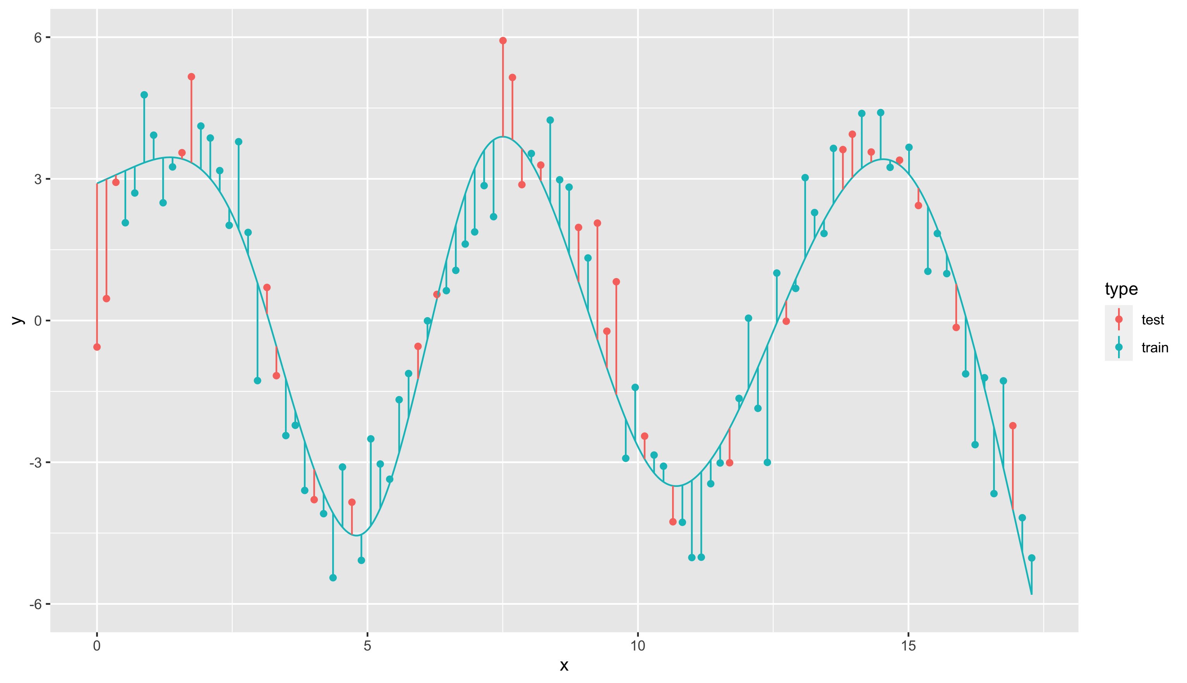
Problem 4: Overfitting
Forward pass (calculate error w.r.t ground truth)
Backwards pass (calculate Δw that decreases error)
Repeat until no
further improvement
Solution 1: Regularization with L2 regularization / weight decay (penalize large weights)
Solution 2: Dropout regularization (randomly shut off neurons)
Solution 3: Early stopping (use validation set)
Solution 4: More data (data augmentation)
Solution 5: Ensemble models

Slide 10
Machine Learning
Computer Vision
Classification

Slide 11

Lesson Goals
Student understands the need for, and the use of, convolutions in Computer Vision
Student can explain the general components and working principles of a convolutional neural network (CNN)
Student can explain the principles of transfer learning, and apply them to a computer vision task
Student can explain the major innovative concepts behind the base pre-trained CNN models
Students understand common evaluation metrics for classification models, both for balanced datasets (ROC curve), and unbalanced datasets (PR curve)

Slide 12

Intro to CV:
Movie

Slide 13

Intro to Computer Vision

Slide 14

Notes:
See AlexNet mp4

Slide 15
Understanding Vision – Where we came from
Notes:
Computer Vision Stanford course: https://www.youtube.com/watch?v=vT1JzLTH4G4&list=PLf7L7Kg8_FNxHATtLwDceyh72QQL9pvpQ

Slide 16

‘Classical’ Image processing & the rise of Computer Vision
Classical CV methods are based on hand-crafted features and heuristics:
Techniques based on differences (in intensity)
Thresholding techniques
Edge Detection techniques (Sobel, Canny, etc.)
Techniques based on similarity
Region-based methods (region growing, watershed algorithms, etc.)
Clustering methods (k-means, mean-shift, etc.)
But…these techniques were flawed: problems with different lightning on images, noise on images, occlusion in images…
In essence: no semantic understanding!

Slide 17
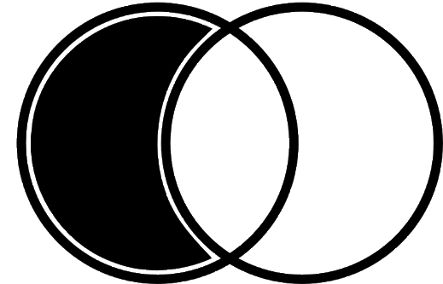
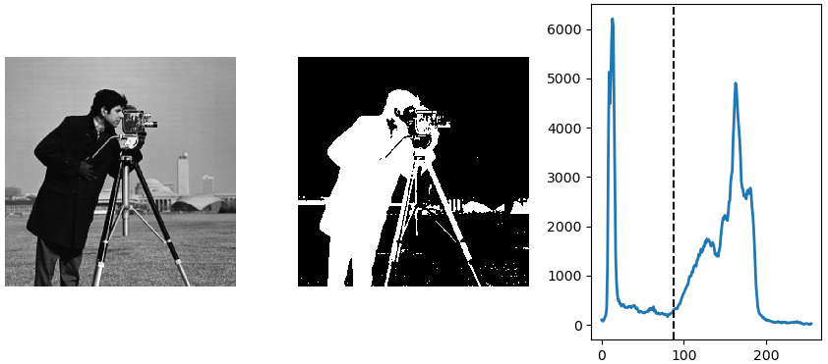
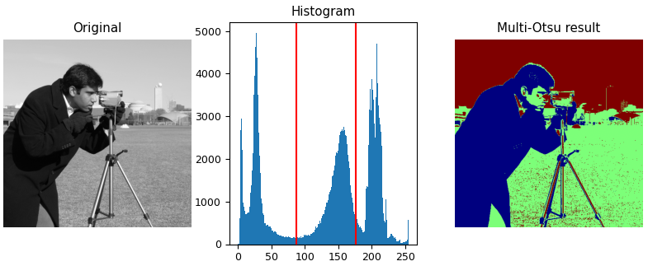
‘Classical’ Computer Vision Thresholding - difference
(Otsu) Thresholding:
Separating foreground from background, using one or more thresholds based on intensity (histograms)
Notes:
https://lectures.scientific-python.org/packages/scikit-image/index.html

Slide 18
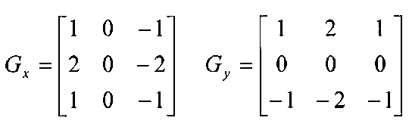
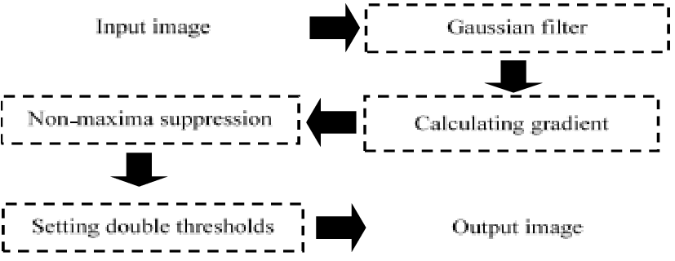
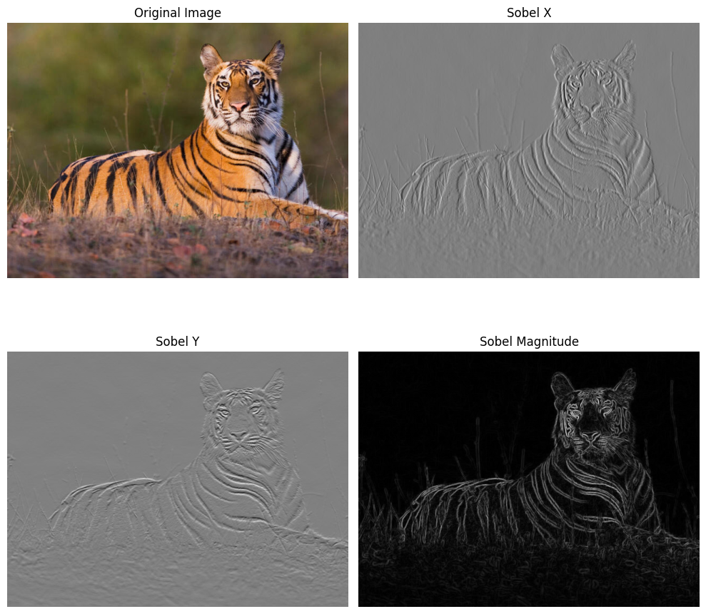
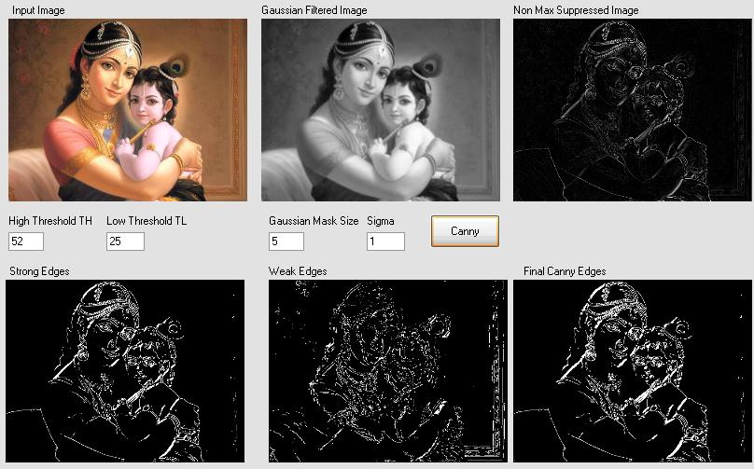
‘Classical’ Computer Vision Edge Detection - difference
Horizontal and Vertical Sobel Edge detectors Canny Edge detectors
Notes:
https://lectures.scientific-python.org/packages/scikit-image/index.html

Slide 19
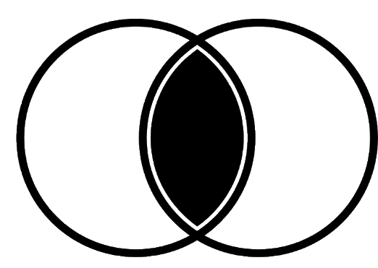
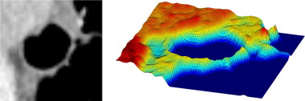
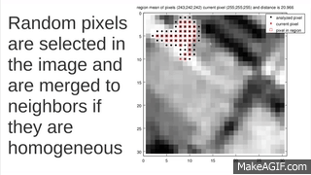
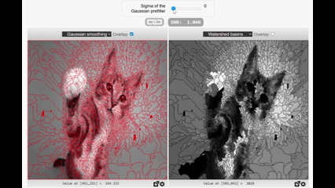
‘Classical’ Computer Vision Region based - similarity
Region Growing Watershed algorithms
Notes:
https://lectures.scientific-python.org/packages/scikit-image/index.html
https://bigwww.epfl.ch/demo/ip/demos/watershed/

Slide 20
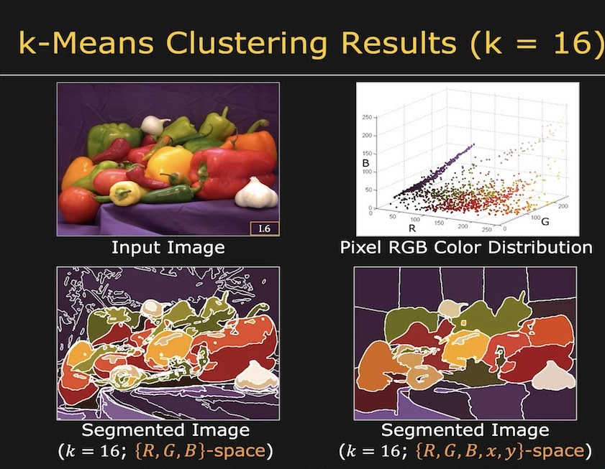
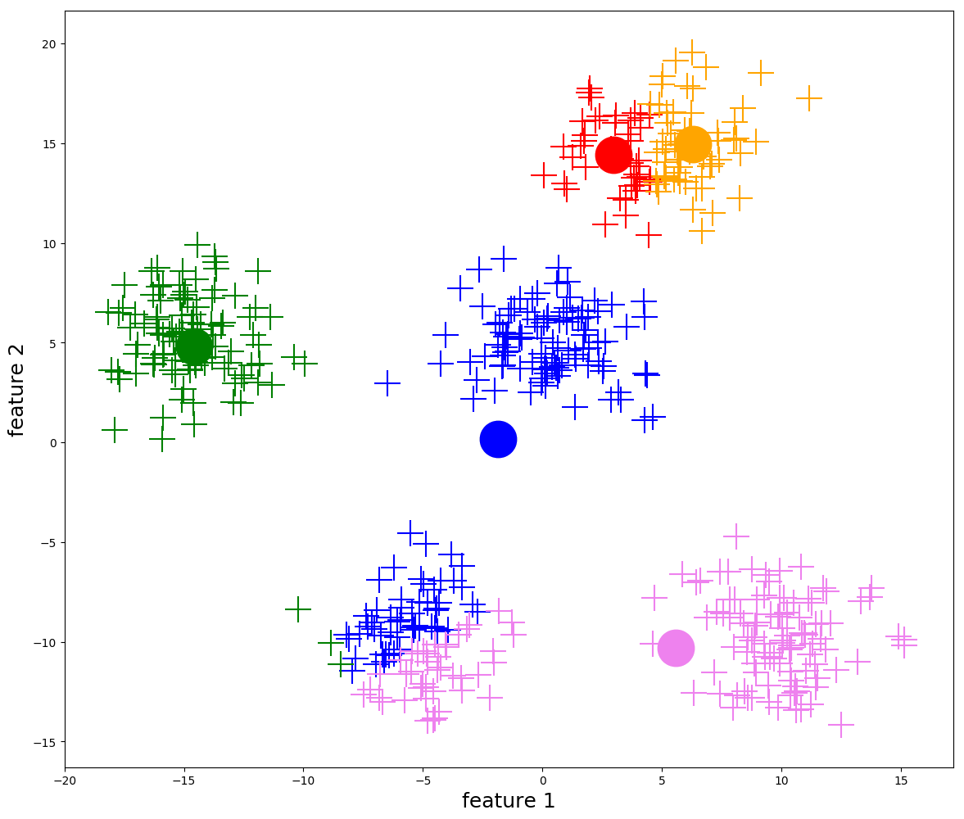
‘Classical’ Computer Vision Clustering - similarity
Clustering based on pixel features: color, texture, etc.
K-means clustering
Notes:
https://lectures.scientific-python.org/packages/scikit-image/index.html
https://primo.ai/index.php/Mean-Shift_Clustering

Slide 21
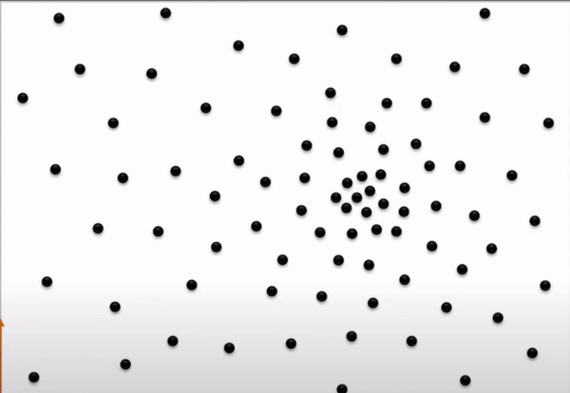
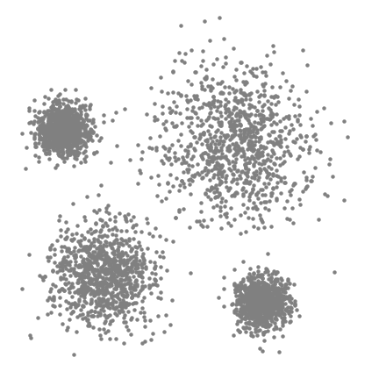
‘Classical’ Computer Vision Clustering - similarity
Clustering based on pixel features: color, texture, etc.
Mean-Shift Clustering: climb the highest ‘density’-peak, by defining a window around each pixel, and shifting the center to the mean of this window. Repeat.
Notes:
https://lectures.scientific-python.org/packages/scikit-image/index.html
https://primo.ai/index.php/Mean-Shift_Clustering

Slide 22
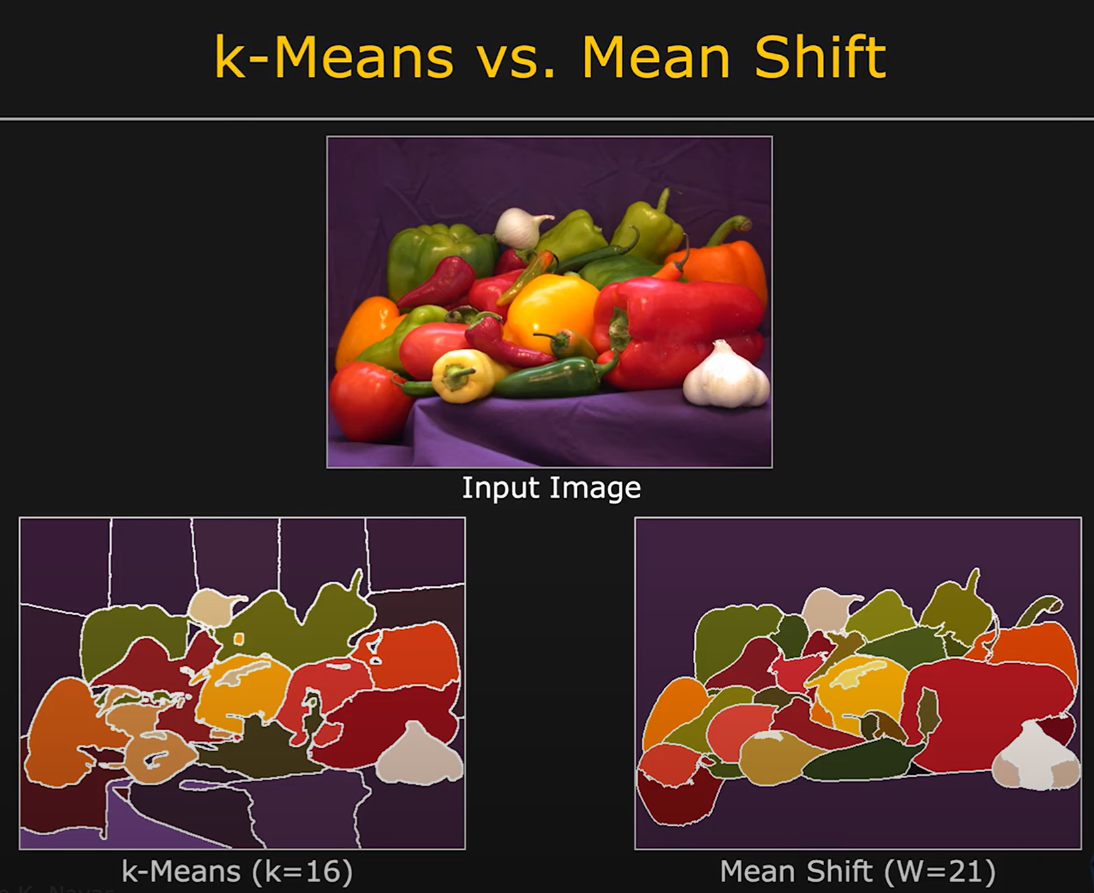
Notes:
https://www.google.com/url?sa=i&url=https%3A%2F%2Fwww.youtube.com%2Fwatch%3Fv%3D22mpExWh1LY&psig=AOvVaw1NwAct-84VsxKI20QmOSbA&ust=1757594951283000&source=images&cd=vfe&opi=89978449&ved=0CBgQjhxqFwoTCLi5rcidzo8DFQAAAAAdAAAAABAE

Slide 23
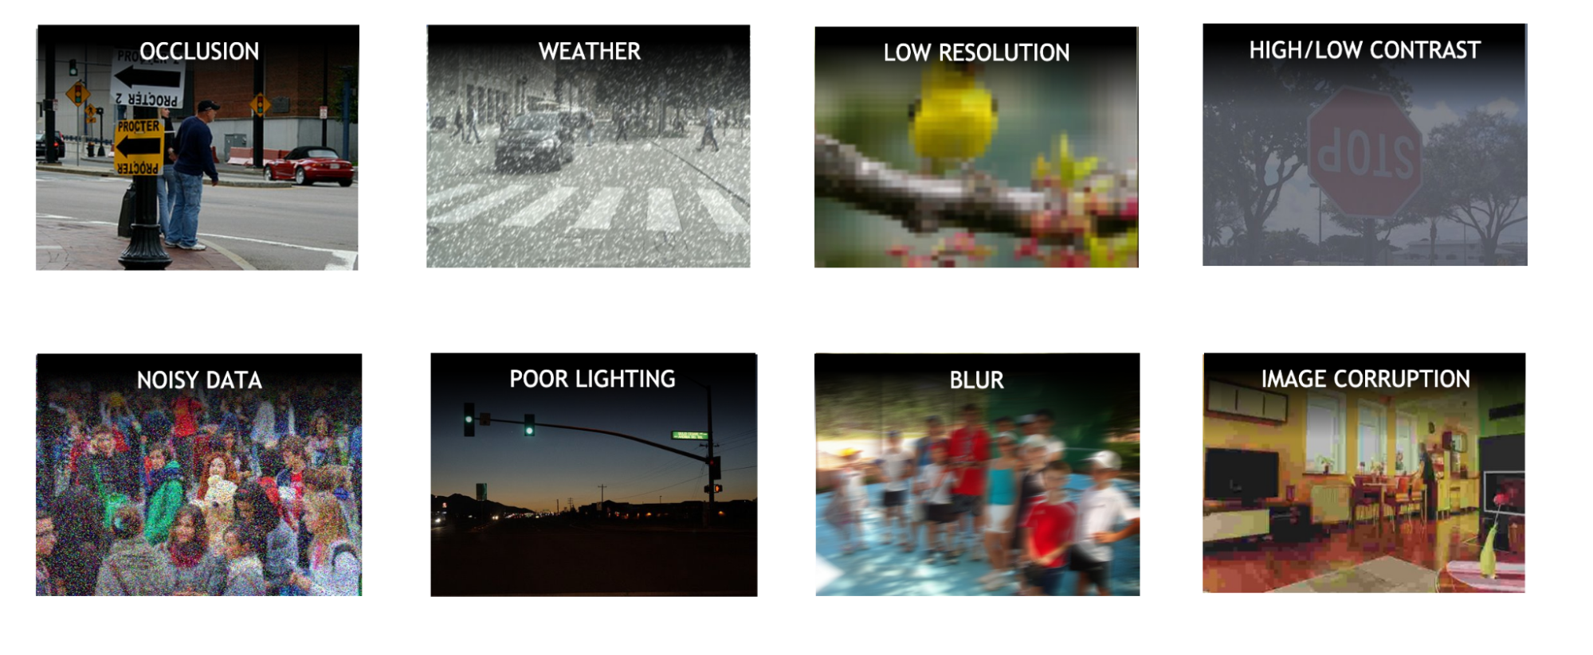
‘Classical’ techniques struggle with real world data
Notes:
https://developer.nvidia.com/blog/improve-accuracy-and-robustness-of-vision-ai-apps-with-vision-transformers-and-nvidia-tao/

Slide 24
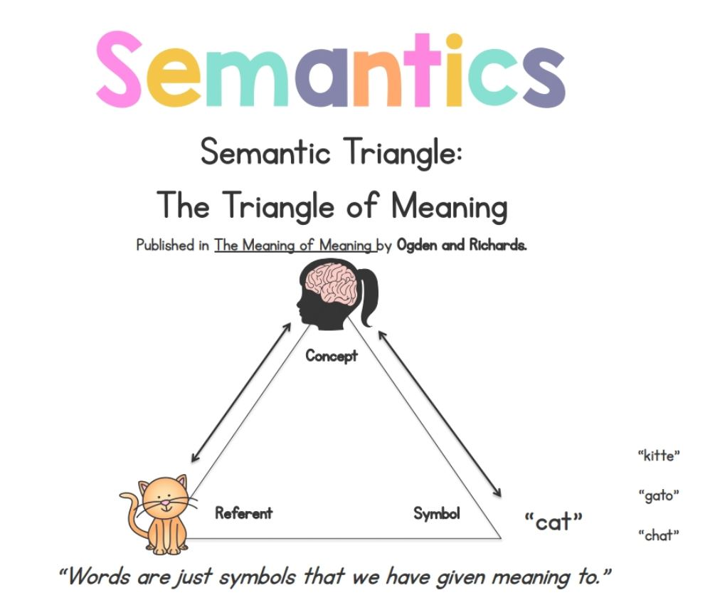
Classical methods miss…

Slide 25

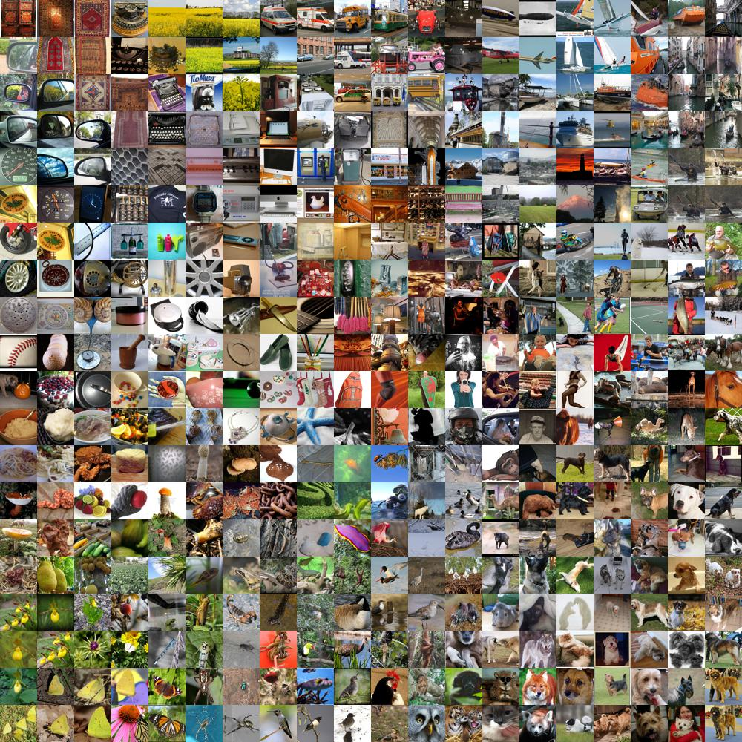
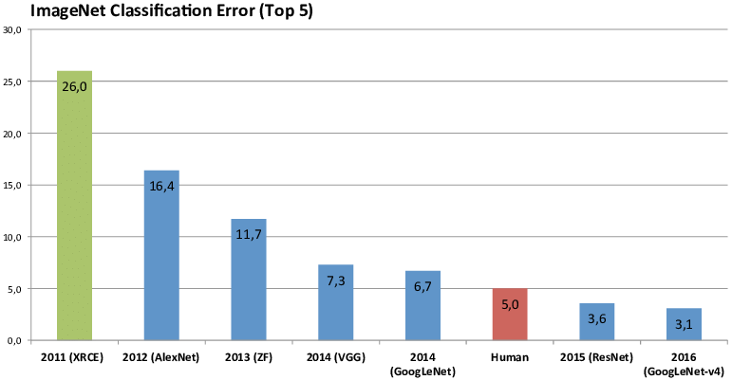
Enter… CNN networks!
1960
2011
2012
2013
2014
2015
2016
Computer vision beginning
14,000,000 labeled images
20,000 categories
ImageNet Classification Error (Top 5)

Slide 26
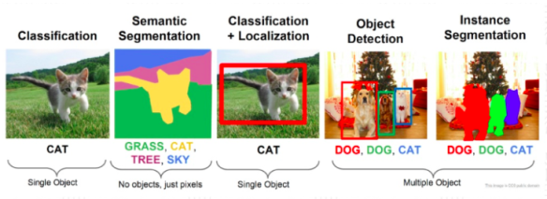
Different level of CV applications What? → Where?

Slide 27

Recap
Convolutional
Neural
Networks
(CNN)
For classification…

Slide 28
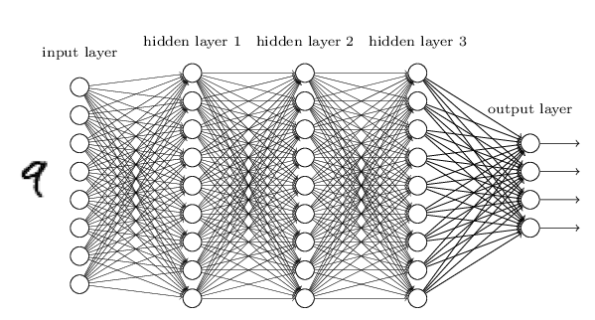
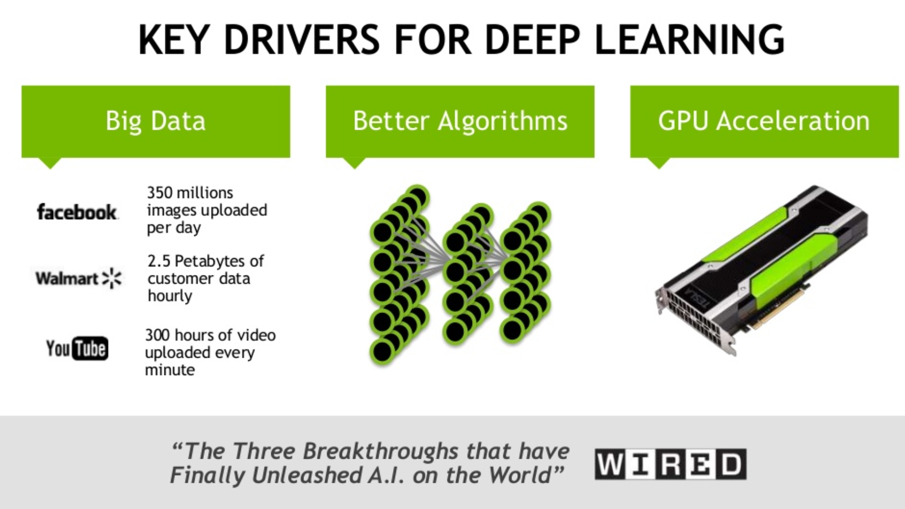

Deep Learning + Images = Magic?
+

Slide 29
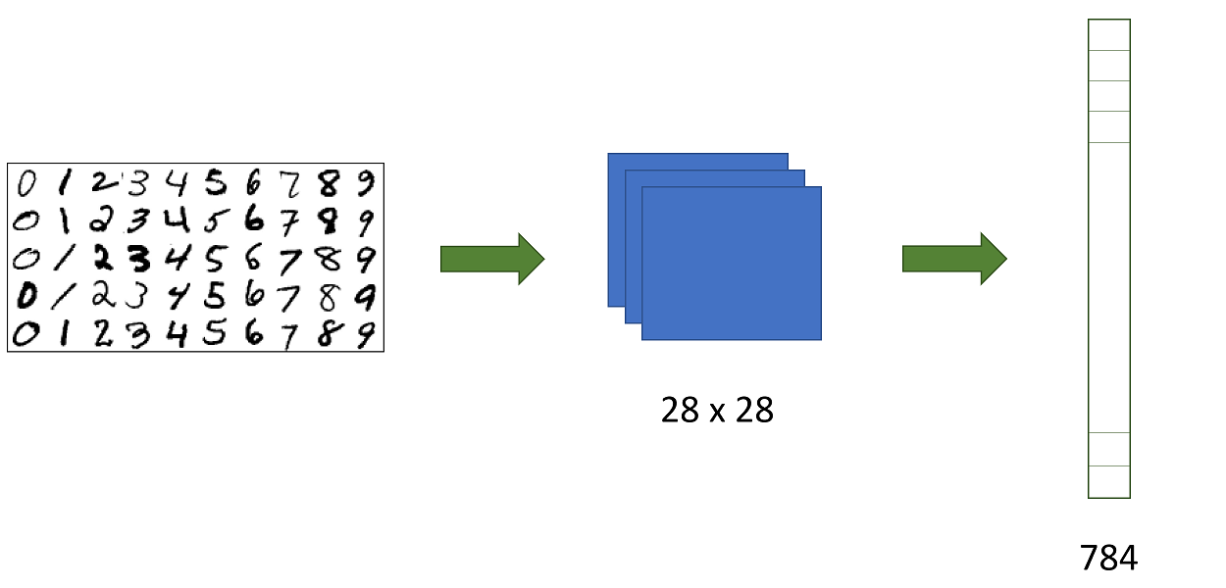
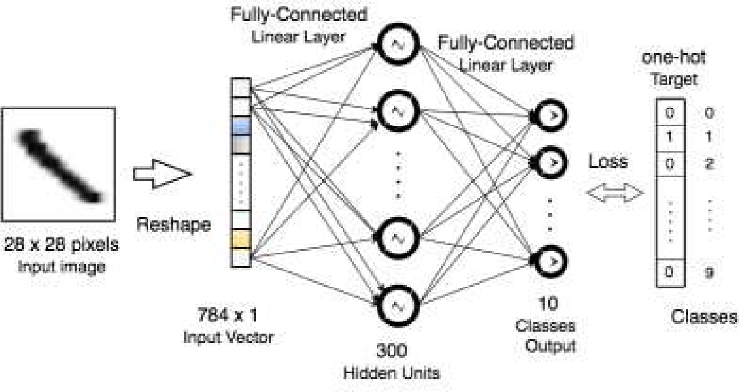

Challenges
Transforming image into 1-D tensor for feeding it into a fully connected neural network
Problem: Parameter explosion
Problem: Location-based information?

Slide 30
Solution: Convolutional Neural Networks

Slide 31
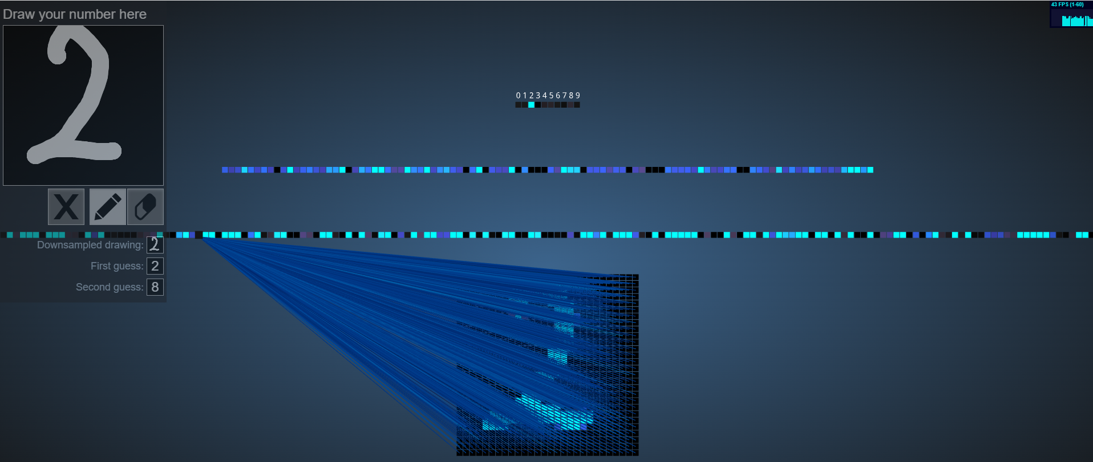
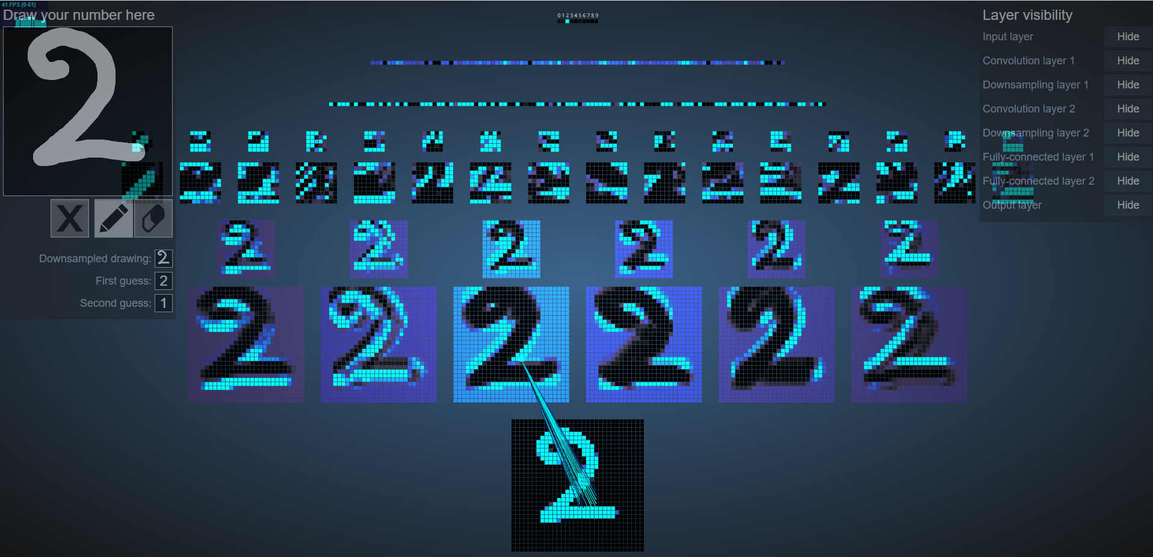
MNIST Visualization FCN: https://adamharley.com/nn_vis/mlp/2d.html CNN: https://adamharley.com/nn_vis/cnn/2d.html

Slide 32

Filtering (by convolutions)

Slide 33
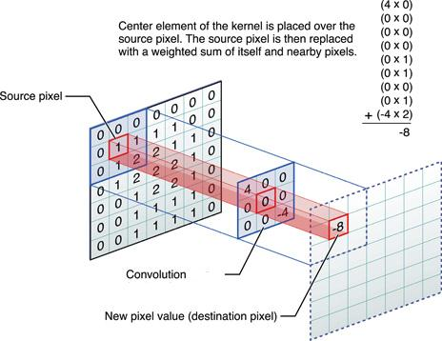

Convolution
Sliding window function, with a ‘kernel’ (filter), resulting in a ‘feature map’

Slide 34
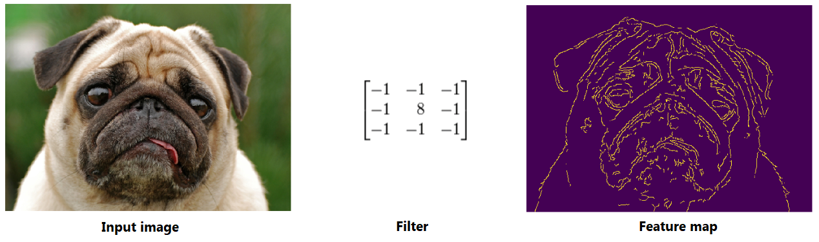
Convolution
Notes:
RELU = Check is it there or not,
Images always RELU

Slide 35
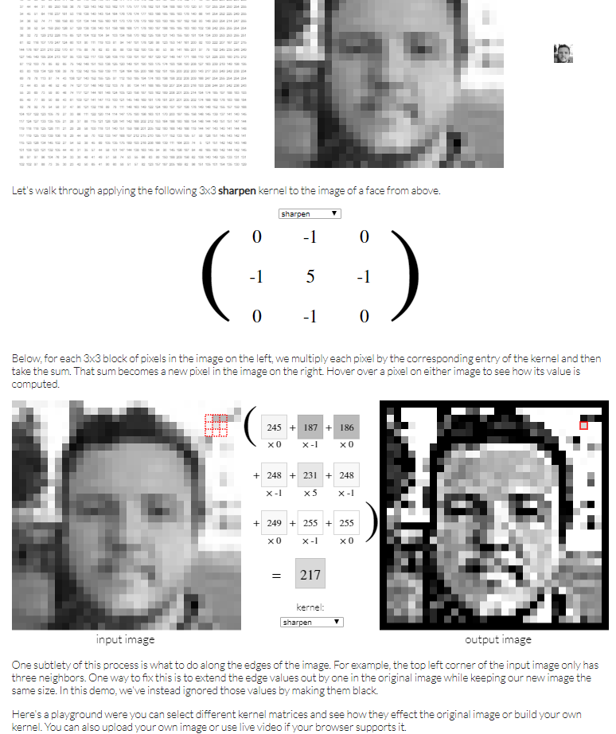
Convolution Playground http://setosa.io/ev/image-kernels/

Slide 36
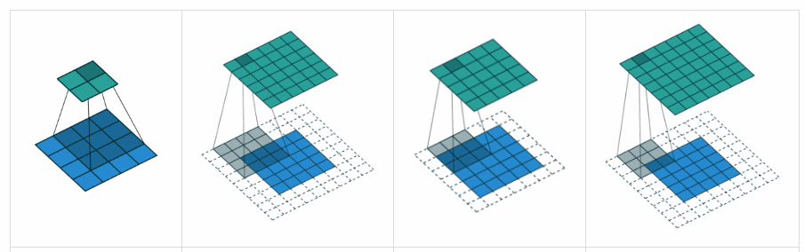
Sliding Window: Padding, Stride
Possible problems
Image shrinks with every convolution
Corner pixels get used less than center pixels
Solution : play with padding & stride
Usually: same pad, & stride of 1

Slide 37
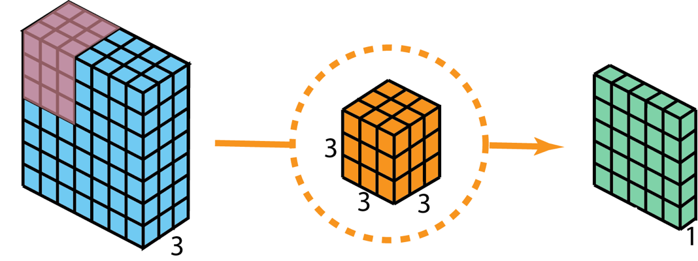
Convolution on an ‘RGB’ image
3 channels all at once, but still 2D-conv!
Usually, kernels have same ‘depth’ as there are channels

Slide 38
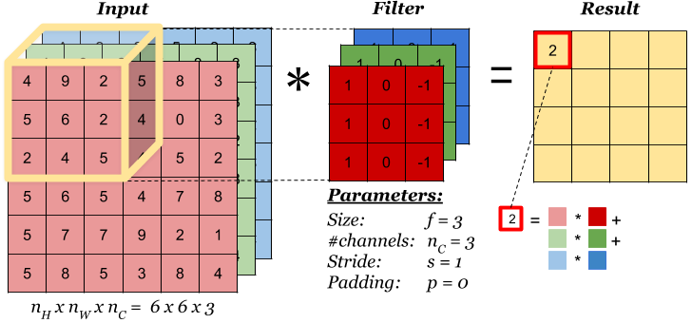
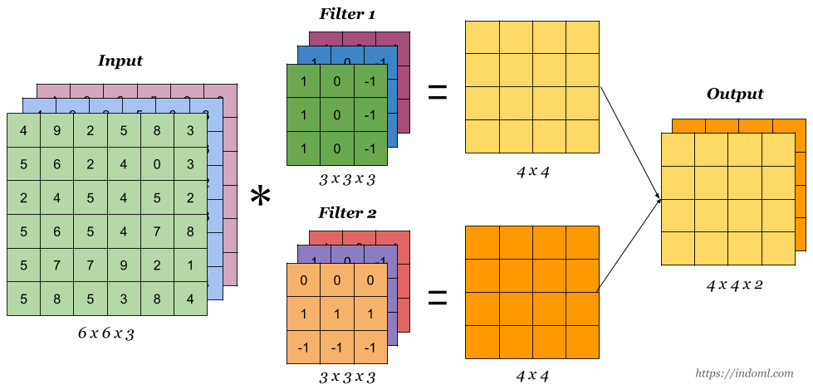
Convolution on an ‘RGB’ image 3 channels all at once, but 2D-conv!

Slide 39
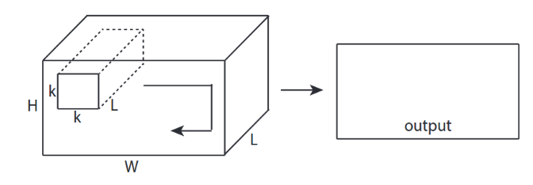
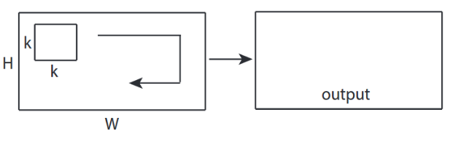
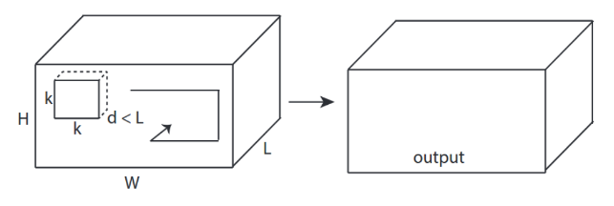
2D Conv – 3D Conv = sliding dimensions, not kernel dimensions
2D Conv
3D Conv

Slide 40

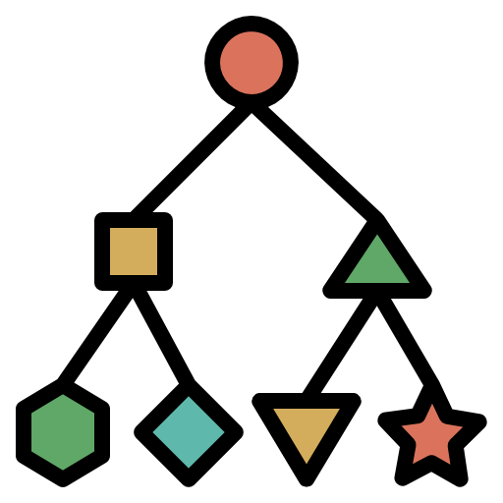
Filtering (by learned convolutions) + task oriented

Slide 41

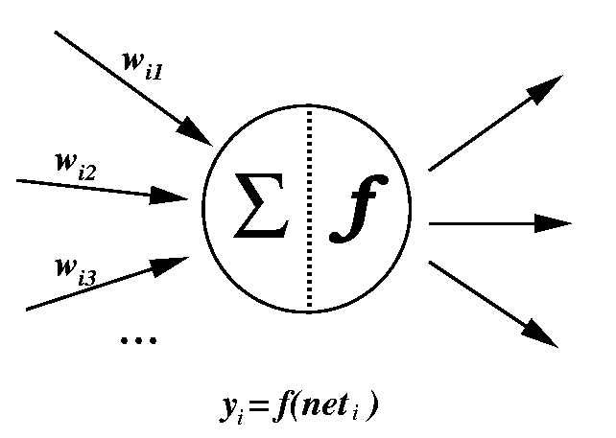
Convolutional Neural Network (CNN)
1.
2.
3.

Slide 42
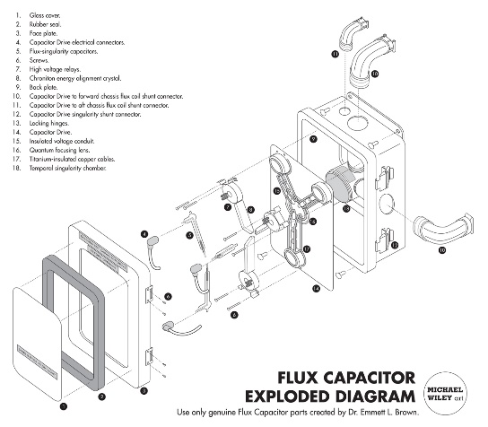
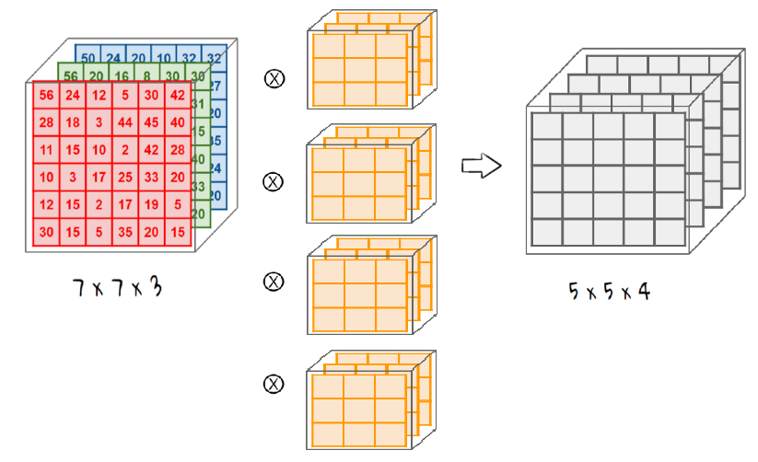
1. Convolution layers ‘Adding Dimensions’
Pulls apart the image into different dimensions, like a filter (kernel)
Image of ‘n’ layers → kernel is ‘n’ layers, so it operates on all channels at once
Applying ‘m’ different kernels to 1 image → ‘m’ new feature maps, that combine into a new ‘image’ of ‘m’ channels (‘m’ dimensions)

Slide 43
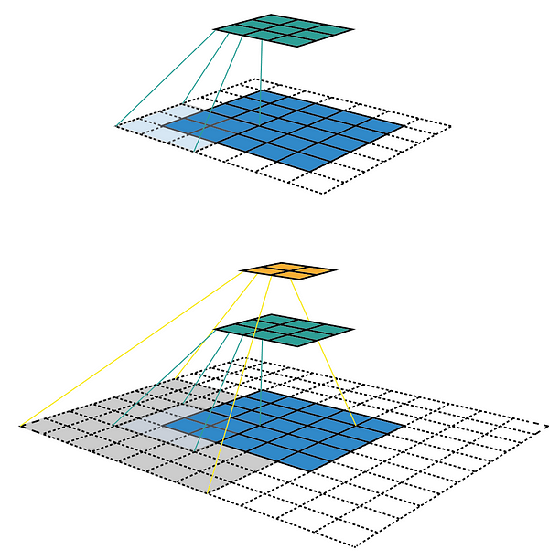
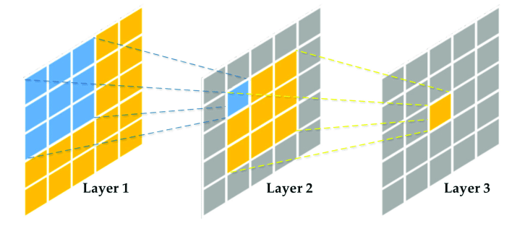
1. Convolution layers Receptive Field (aggregations)
Receptive field starts locally, but aggregates to more global views (also with pooling techniques)
Local view Global view

Slide 44
Convolutional Neural Network (CNN)
1.
2.
3.

Slide 45

2. Pooling layers Reduce in size, aggregate, subsample
Pooling reduces the size of the image (not the number of channels, but the size)
Zoom in on important parts
Less parameters to keep track of, and calculate with

Slide 46



2. Pooling layers Max Pooling vs Average Pooling

Slide 47

2. Pooling layers Why are they useful?

Slide 48
Convolutional Neural Network (CNN)
1.
2.
3.

Slide 49

3. Classification layers Flattening into 1-D + classify
Reduce all layers into 1 big flat vector + add universal approximator

Slide 50


3. Classification layers Flattening versus Global Average Pooling (GAP)
With Flattening, we still need to learn which parts are important for the output neuron
+ can handle complex patterns
- more calculations needed
In GAP, we take a shortcut. When we do enough convolutions, the average of a feature map is a good predictor for the output neuron
+ simplification, faster
- sometimes too simple

Slide 51

Convolutional Neural Network (CNN)

Slide 52

Transfer Learning

Slide 53


Problem statement:
Deep neural network architectural design is still more of an art-form, and proves to be pretty challenging!
And, it is also data hungry, and time consuming to train

Slide 54

Enter: CV Benchmark Competition - Imagenet

Slide 55
Competition drives innovation
Big, deep CNN networks started to win the competition
Yearly new innovations in CNN architecture
Architectures + weights are open sourced

Slide 56

Example of pre-trained network

Slide 57


Re-usable Model Body
‘Body’
‘Head’

Slide 58

Transfer Learning: two modes

Slide 59


Base Models
Evolution to ‘Foundational Models’, even multi-modal models
i.e.: using different modes of knowledge input, to transform the information into multi-dimensional latent space

Slide 60

Pre-trained base models
Model zoo

Slide 61

Evolution of CNN base models More layers = more CNN power!

Slide 62

Compute Needs (by architecture) (BN = adding BatchNormalization layers)

Slide 63

0. LeNet (Yann LeCun) - 1998
One of the first CNN architectures, but not very deep
Mainly for handwritten digit recognition (MNIST dataset)
Foundation for the later CNN networks that compete in the imagenet competition

Slide 64

1. Alexnet (Alex Krizhevsky, Geoffrey Hinton) - 2012
The one that started it all!
Innovation: Deep CNN (8 layers) with ReLU’s and Dropout

Slide 65


2. VGG (visual geometry group @Oxford) - 2014
Innovation:
Lots of small kernels / filters outperforms one single big one
Less parameters are needed for smaller kernels, so we can have more layers = deeper network!
Smaller kernels capture more details

Slide 66

VGG Family (variations)

Slide 67



Identity Conv: 1x1 conv
1x1 conv can be used as a ‘bottleneck’ layer, to ‘squeeze’ knowledge, and non-linearity
Mostly used as a trick to adjust number of channels in a computational efficient way (dimensionality reduction)
Notes:
https://medium.com/analytics-vidhya/talented-mr-1x1-comprehensive-look-at-1x1-convolution-in-deep-learning-f6b355825578

Slide 68



1x1 conv = computational ‘trick’
Notes:
https://medium.com/analytics-vidhya/talented-mr-1x1-comprehensive-look-at-1x1-convolution-in-deep-learning-f6b355825578

Slide 69

3. Inception – GoogLeNet - 2014
Innovation:
Inception modules combine small & large kernels (with the 1x1 conv trick) → not only go deep, but also wide!
Small kernels: focus on details, more local patterns
Large kernels: focus on more broad stroke patterns, global patterns
Module = combine them

Slide 70

Inception module (optimized via 1x1 bottleneck)
Notes:
3x3 Max Pooling followed by 1x1 Convolution:
Max Pooling: This operation reduces the spatial dimensions (width and height) of the input feature maps while retaining the most important features. It helps in downsampling the input, which reduces the computational load for subsequent layers.
1x1 Convolution: After max pooling, the 1x1 convolution is applied to reduce the depth (number of channels) of the feature maps. This step is crucial for dimensionality reduction and helps in controlling the number of parameters and computations¹.
1x1 Convolution followed by 3x3 Convolution:
1x1 Convolution: This operation is used to reduce the depth of the input feature maps before applying the more computationally expensive 3x3 convolution. By reducing the number of channels first, the subsequent 3x3 convolution operates on a smaller depth, which significantly reduces the number of parameters and computations².
3x3 Convolution: This operation captures spatial features from the input feature maps. Since the depth has already been reduced by the 1x1 convolution, the 3x3 convolution is more efficient².

Slide 71



4. ResNet (the go-to option!) - 2015
Innovation:
Skip connections (shortcuts)
Residual learning forces the model to learn the ‘rest’, what other the other layers didn’t (the details)
Skip connections create shortcuts for easier backpropagation of the gradient, so we can go deeper (more layers)
Notes:
https://www.analyticsvidhya.com/blog/2021/08/all-you-need-to-know-about-skip-connections/

Slide 72


Side by side comparison

Slide 73


5. DenseNet - 2016 (skip-connections overkill?)

Slide 74

But…CNNs are localized…
Convolution uses local window (receptive field), and thus lacks global understanding
Enter: Transformers with the attention mechanism!
Convolution: local view Attention: global view

Slide 75

6. ViT (Vision Transformer)
Transformer architecture = different Neural Network architecture
See NLP part of the course

Slide 76

Going Practical…

Slide 77



Hugging Face: Open-source models

Slide 78

Advanced Settings / Tweaks fastai Finetune: Fit One Cycle - Unfreeze

Slide 79


Advanced Settings / Tweaks LR finder
Frozen Base model Unfrozen Base Model
Notes:
LR finder → quickly try out different learning rates

Slide 80


Advanced Settings / Tweaks Discriminative Learning rates - Slice

Slide 81


Advanced Settings / Tweaks FP-16 Mixed Precision

Slide 82

CV models are now better than humans…

Slide 83



Looking ahead… Object Detection: Yolo CNN backbone

Slide 84

But…even Yolo can make mistakes

Slide 85

Power of CNNs,
used differently

Slide 86


Sound as image (spectogram)

Slide 87

Mouse movements & clicks Human? Fraude detection

Slide 88

Code as image Detect malware

Slide 89

The Godfathers of AI

Slide 90

The Godfathers of AI Winners of the Turing Award 2018
Yann LeCun (LeNet)
Geoffrey Hinton (AlexNet)
Yoshua Bengio (Attention mechanism)

Slide 91

(Common) Model Evaluation Metrics

Slide 92

Not the focus of this part of the course (check Cloud AI)

Slide 93

Notes:
Examples When Precision is Important (High Cost of False Positives)
Spam Detection: In email filtering, marking a legitimate email as spam (false positive) can cause important communications to be missed.
Medical Diagnosis: In cancer screening, a false positive can lead to unnecessary stress, invasive procedures, and treatments for patients.
Fraud Detection: In financial transactions, falsely flagging a legitimate transaction as fraudulent can inconvenience customers and damage trust.
Autonomous Vehicles: In obstacle detection, a false positive (detecting an obstacle that isn’t there) can cause unnecessary stops or dangerous maneuvers.
Examples When Recall is Important (High Cost of False Negatives)
Disease Outbreak Detection: Missing a case of a contagious disease (false negative) can lead to an uncontrolled outbreak.
Security Screening: In airport security, failing to detect a threat (false negative) can have severe safety implications.
Customer Churn Prediction: In business, failing to identify a customer who is likely to leave (false negative) can result in lost revenue.
Search Engines: In information retrieval, not retrieving relevant documents (false negatives) can lead to incomplete or unsatisfactory search results.

Slide 94


Slide 95
Evaluating Classification Models Summary
Unbalanced dataset
Use the PR curve
Focuses on the positive class, which might be rare in the dataset
Single metric: F1-score
Single ‘area’ metric: AUC-PR, or AP
Balanced dataset
Use the ROC curve
Provides a broad and balanced performance overview, comparing True Positive Rate versus False Positive Rate
Single ‘area’ metric: AUC-ROC
Notes:
Deep learning datasets are often unbalanced

Slide 96

Unbalanced Dataset

Slide 97



Evaluating Classification Models Precision & Recall
Confusion Matrix, because accuracy is too limited
Precision (positive predictive value): describes how well a model predicts the positive class. Priority on ‘correctness’.
Recall (sensitivity) tells you if your model made the right predictions when it should have. Priority on ‘completeness’.
Notes:
https://www.v7labs.com/blog/mean-average-precision

Slide 98

Classification Threshold
But… Classification model always predicts a probability
True sample: when > 0,5 probability
Negative sample: when < 0,5 probability
When we change this threshold, our TP / FP / TN / FN values change!
When we put the threshold on 0,8, we’ll have less cases we predict as positive, and more cases we predict as negative…
Notes:
https://www.evidentlyai.com/classification-metrics/classification-threshold

Slide 99

Precision – Recall Trade-off
Precision prioritizes “correctness” but may not account for the cost of missing positive cases.
Recall emphasizes “completeness” but may result in falsely flagging some instances.
Both types of errors can be expensive, depending on the specific use case.
Higher threshold → our precision will be better, but our recall might be worse.
Lower threshold → our recall might be better, but our precision might be worse.

Slide 100

Precision – Recall Trade-off
Notes:
https://www.v7labs.com/blog/precision-vs-recall-guide

Slide 101


Precision – Recall Curve
EXAMEN
Plotting the Precision-Recall values at different thresholds → Precision-Recall Curve!
With this curve, we can:
Identify the optimal threshold that balances precision and recall for our use case
Understand how changes in the threshold affect the model’s performance.
Compare the performance of different models or configurations.
Notes:
https://www.datacamp.com/tutorial/precision-recall-curve-tutorial
EXAM QUESTION PRECISION RECALL CURVE!! Area calc= F1 score

Slide 102


Precision – Recall Curve

Slide 103



Capture PR Curve into one single metric
Different ‘aggregate’ ways to summarize the info of the PR curve into one number
F1 Score
Represents a single point on the precision-recall curve, balancing precision and recall at a specific threshold.
PR-AUC (Area Under the Curve):
Measures the entire area under the PR curve, using all points to evaluate the model’s overall ability to distinguish between classes.
Integrates the area under the curve = exact area measurement
Average Precision (AP):
Averages precision across several recall levels and averages them, using step function.
Estimate of the area under the curve
EXAMEN
Notes:
Exam question:: How good is the model? → That all depends on the use case
3ways to calc:
→F1 score
All usecases → area under curve exact calc
Quick and dirty → avg boxes avg amount

Slide 104

Balanced Dataset

Slide 105

Trade-off between TPR and FPR
Notes:
While ROC curves are useful for balanced datasets, they can be overly optimistic in imbalanced datasets because they include the true negative rate, which can be misleading when the number of negative instances is much larger than the number of positive instances.
Originally developed in World War 2 for radar installations, to distinguish between a flock of birds, versus a plane

Slide 106



ROC Curve

Slide 107


Slide 108
Evaluating Classification Models Summary
Unbalanced dataset
Use the PR curve
Focuses on the positive class, which might be rare in the dataset
Single metric: F1-score
Single ‘area’ metric: AUC-PR, or AP
Balanced dataset
Use the ROC curve
Provides a broad and balanced performance overview, comparing True Positive Rate versus False Positive Rate
Single ‘area’ metric: AUC-ROC

Slide 109



Over to you

